Slide 1

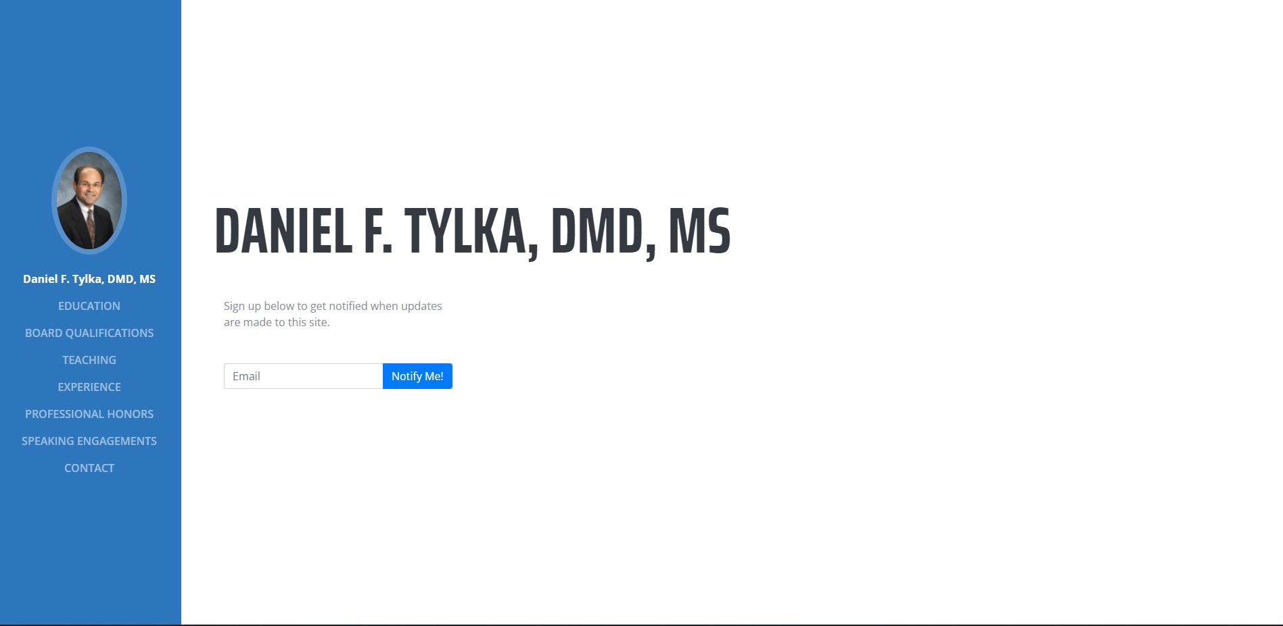

Slide 2
Action Plan
Only using .com top-level domain (ON HOLD)
Change resume site to resume.drtylka.com
Build new drtylka.com site
Select drtylka.com theme
Implement truForm registration

Slide 3
Action Plan – 1 (ON HOLD)
Only use .com top-level domain
Save $48 per year
Remove the following:
DOCTYLKA.COM
DOCTYLKA.NET
DRTYLKA.INFO
DRTYLKA.ORG
I’ll need login details for your Go Daddy account to remove them

Slide 4
Action Plan - 2
Change resume site to resume.drtylka.com
Using a subdomain has no additional cost and easy to set up
Frees up drtylka.com for new site

Slide 5
Action Plan – 3 & 4
Select Drtylka.com theme
~$30 for a theme
I would recommend using this site: https://bootstrapmade.com/
Most modern templates here: https://bootstrapmade.com/bootstrap-5-templates/
Build new drtylka.com site
$100 per page

Slide 6
Action Plan - 5
Implement truForm registration
$200 implementation cost
I’m waiting to hear back from truForm on cost

